Slide 1

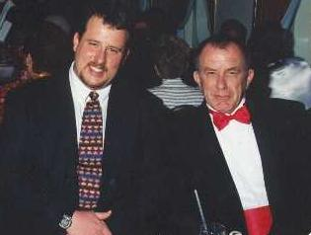
Exposure CS 2021
for CS1
Chapter 7
Output Slides
For Teachers
PowerPoint Presentation
created by:
Mr. John L. M. Schram
and Mr. Leon Schram
Authors of Exposure
Computer Science

Slide 2
Output Programs
These slides will present a variety of small programs. Each program example either has a selection control structure or some type of numeric formatting.
Our concern will be with the output of each program, and more importantly, developing a way to determine program output correctly for programs that involve selection control structures and numeric formatting.
You can expect that on quizzes and/or tests that only a program segment may be shown.

Slide 3

Teacher/Student Versions, Tablet PCs, and Inking
The “For Teachers” version of this presentation has 2 or more slides for each program.
The first slide only shows the program.
The other slide(s) show the program, worked out solution, and output.
The “For Students” version
only has 1 slide for each
program with no provided
solution or output. Students are
expected to work out the solutions either on paper, or ideally they can “ink” directly on their laptops.

Slide 4
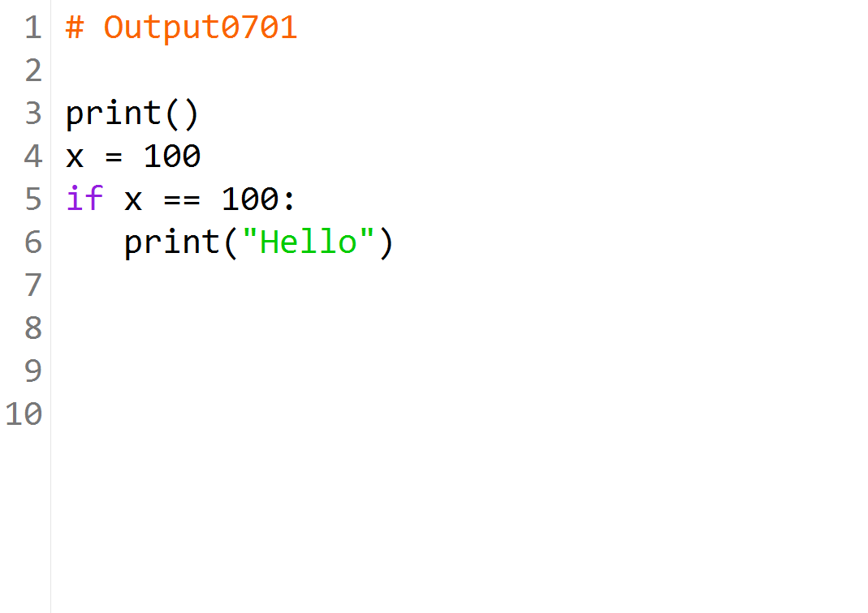

Slide 5
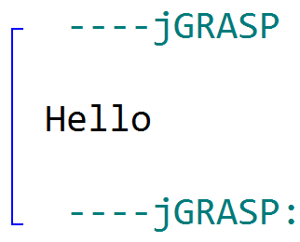
x | x == 100? | Output
100 | True | Hello

Slide 6


Slide 7
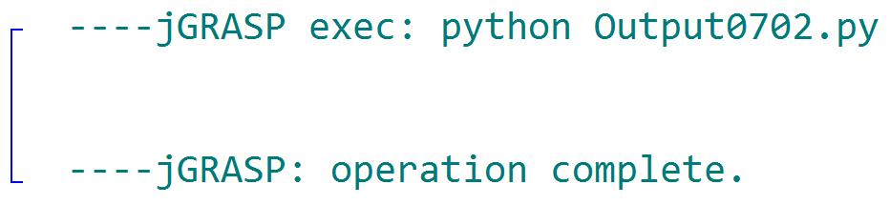
x | x == 100? | Output
99 | False | [none]

Slide 8
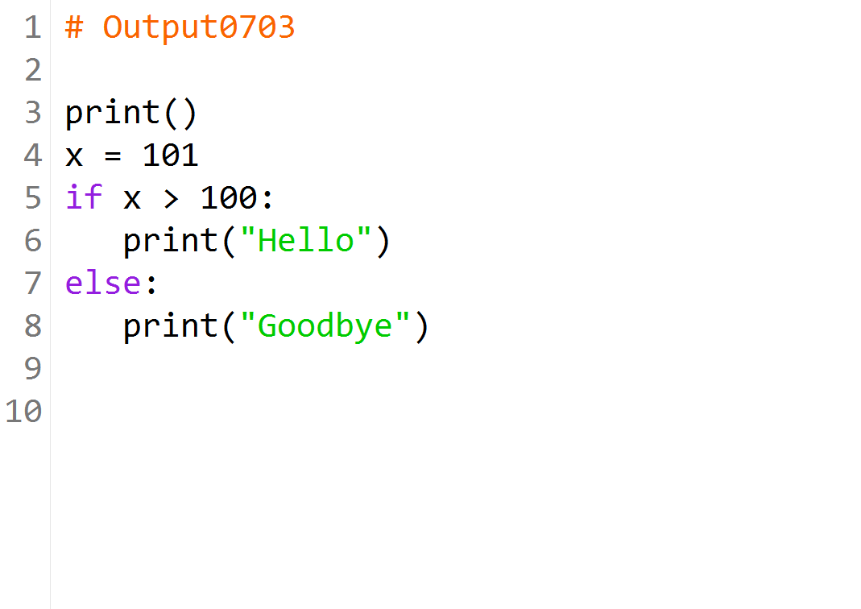

Slide 9
x | x > 100? | Output
101 | True | Hello

Slide 10
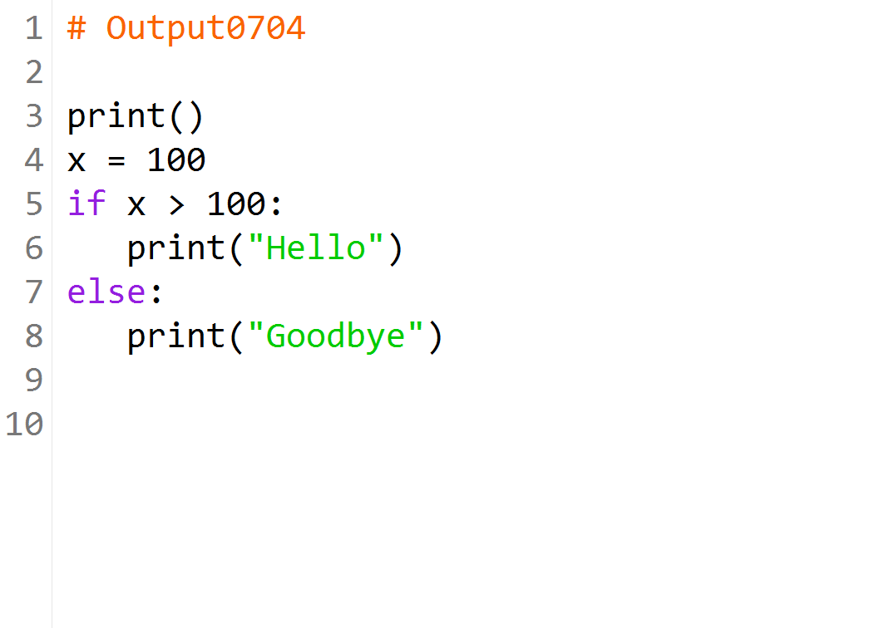

Slide 11
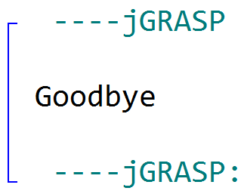
x | x > 100? | Output
100 | False | Goodbye

Slide 12
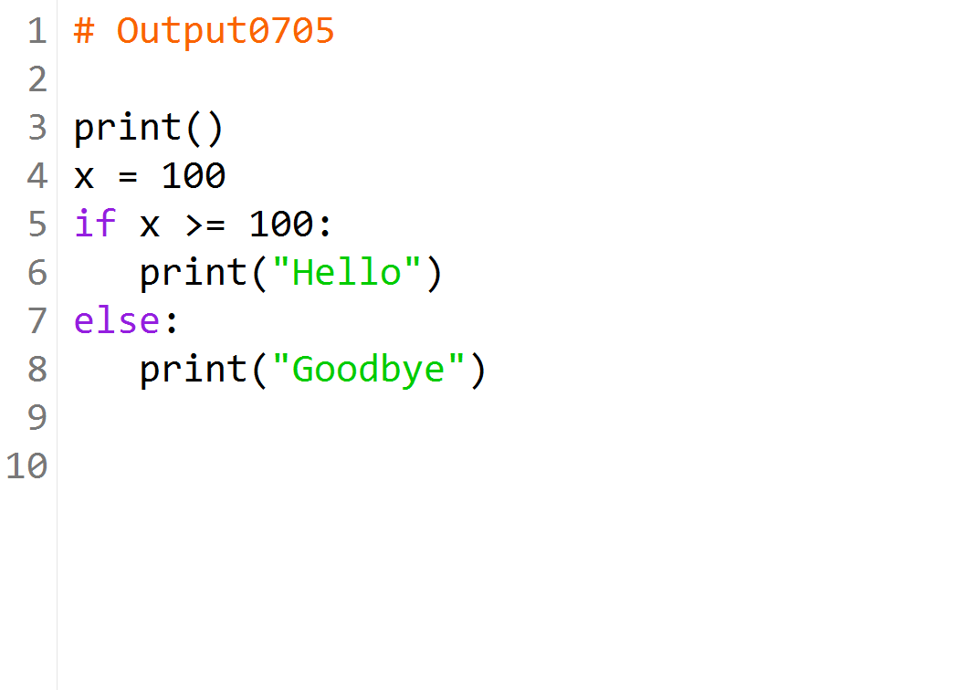

Slide 13
x | x >= 100? | Output
100 | True | Hello

Slide 14
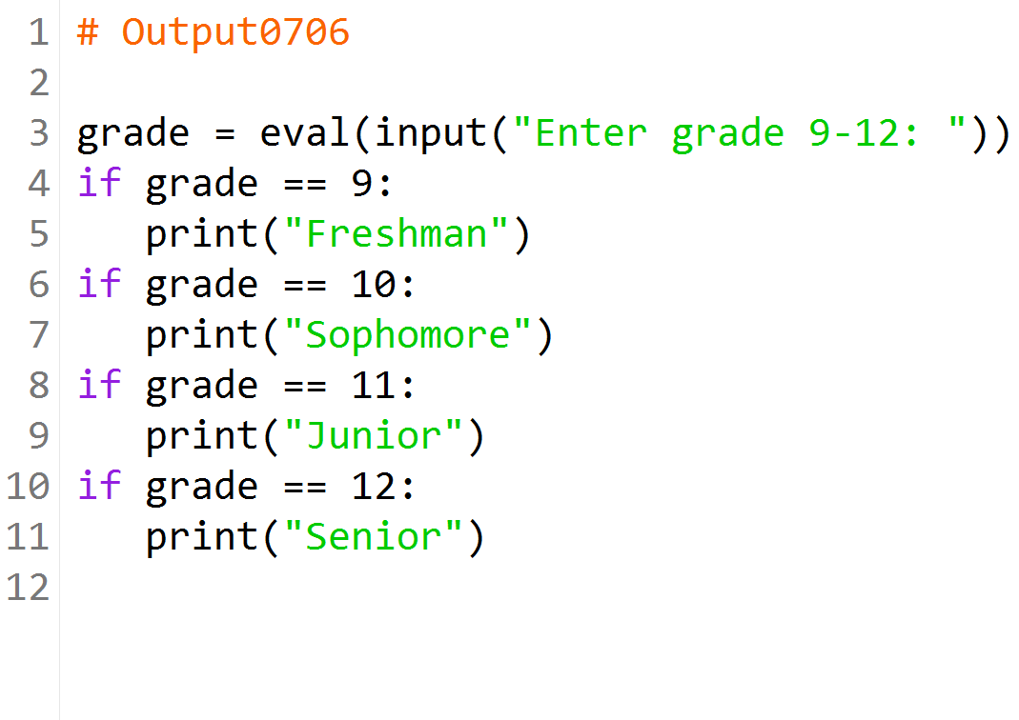
What is the output after the user enters 10?

Slide 15
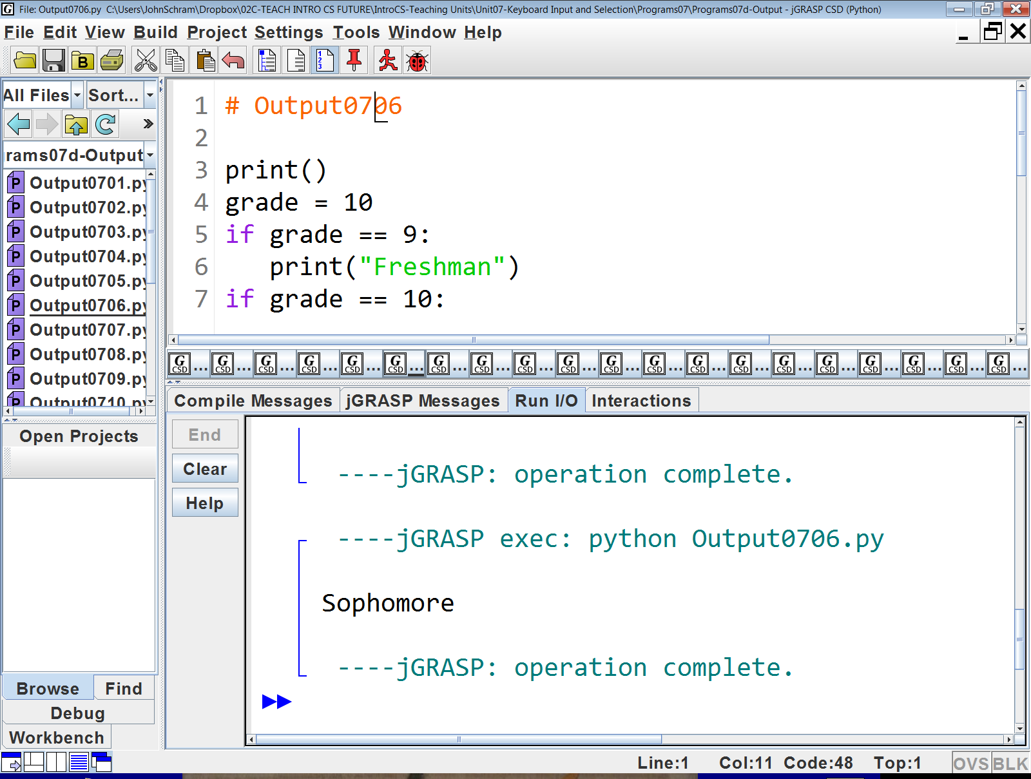
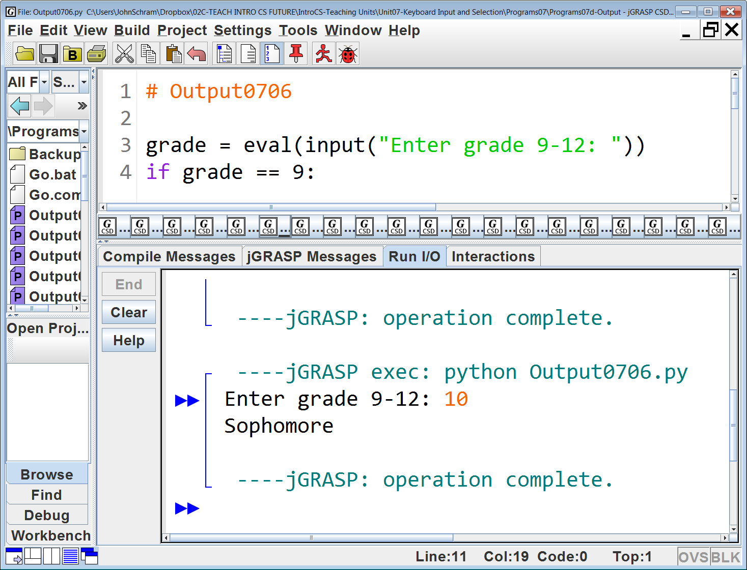
Comparison | Output
10 == 9?, false | [none]
10 == 10?, true | Sophomore
10 == 11?, false | [none]
10 == 12?, false | [none]

Slide 16
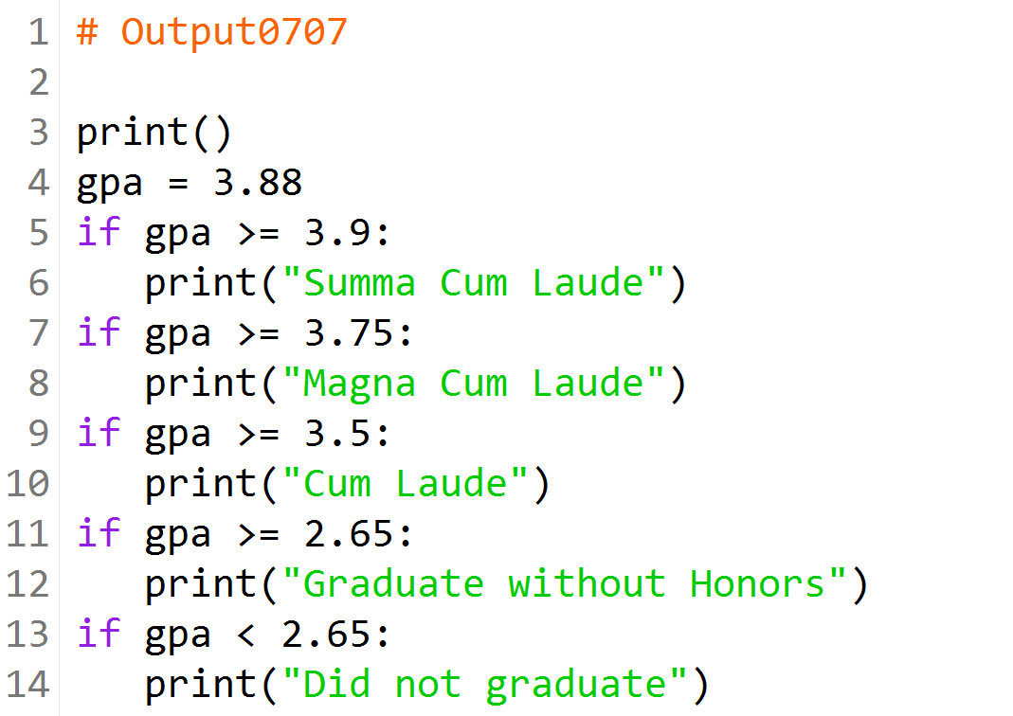

Slide 17
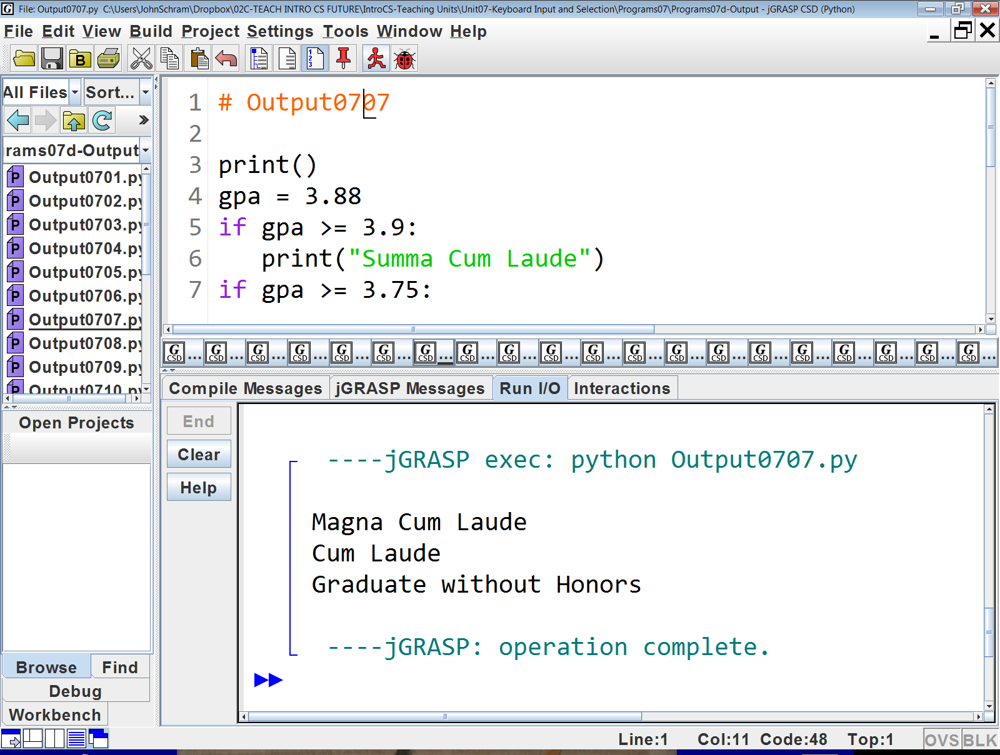

Slide 18
Comparison | Output
3.88 >= 3.9?, False | [none]
3.88 >= 3.75?, True | Magna Cum Laude
3.88 >= 3.5?, True | Cum Laude
3.88 >= 2.65?, True | Graduate without Honors
3.88 < 2.65?, False | [none]

Slide 19
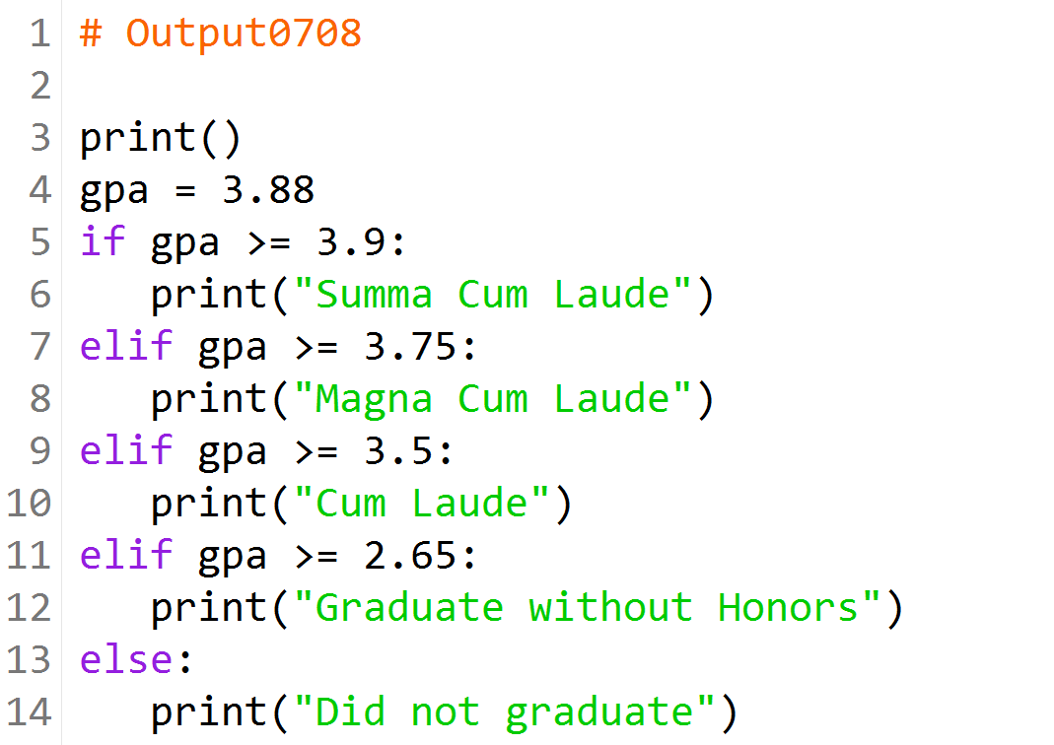

Slide 20
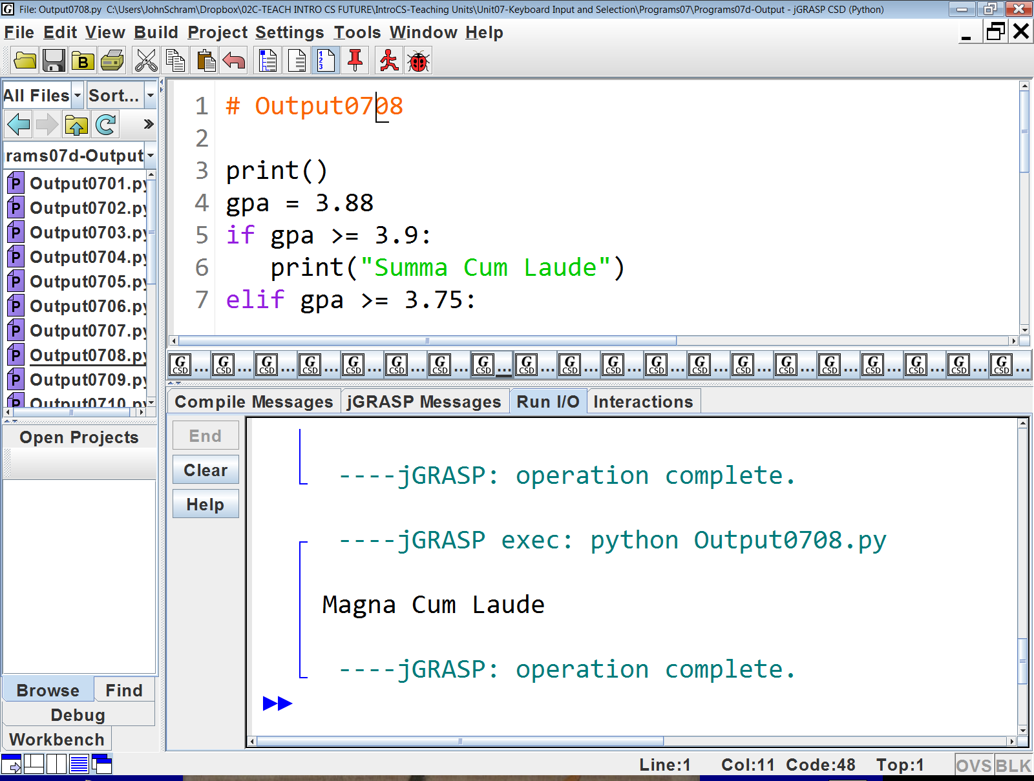

Slide 21
Comparison | Output
3.88 >= 3.9?, False | [none]
3.88 >= 3.75?, True | Magna Cum Laude
Then it stops because elif is used.

Slide 22
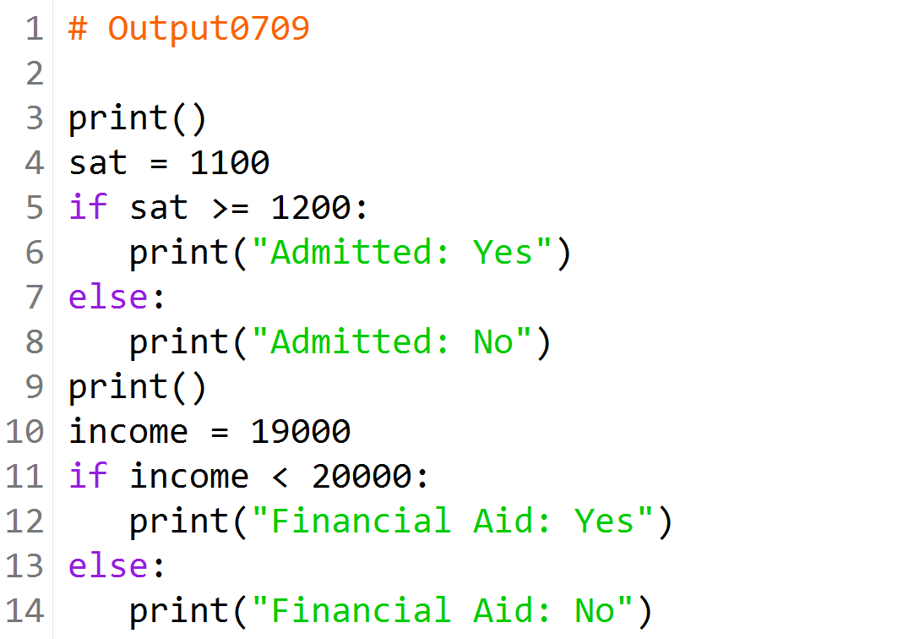

Slide 23
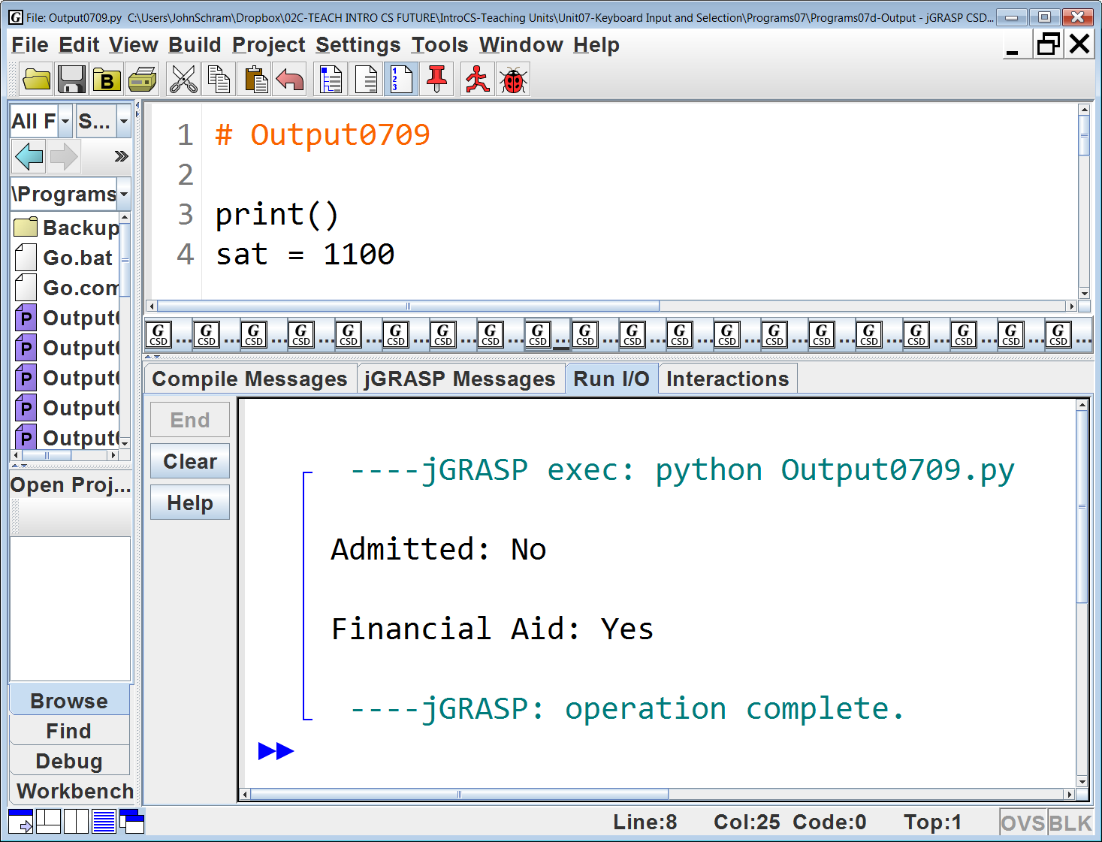

Slide 24
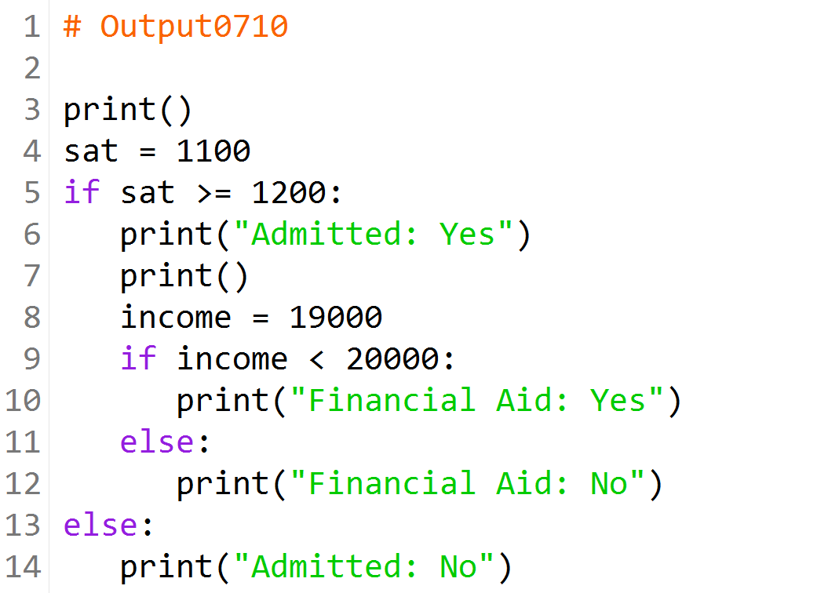

Slide 25
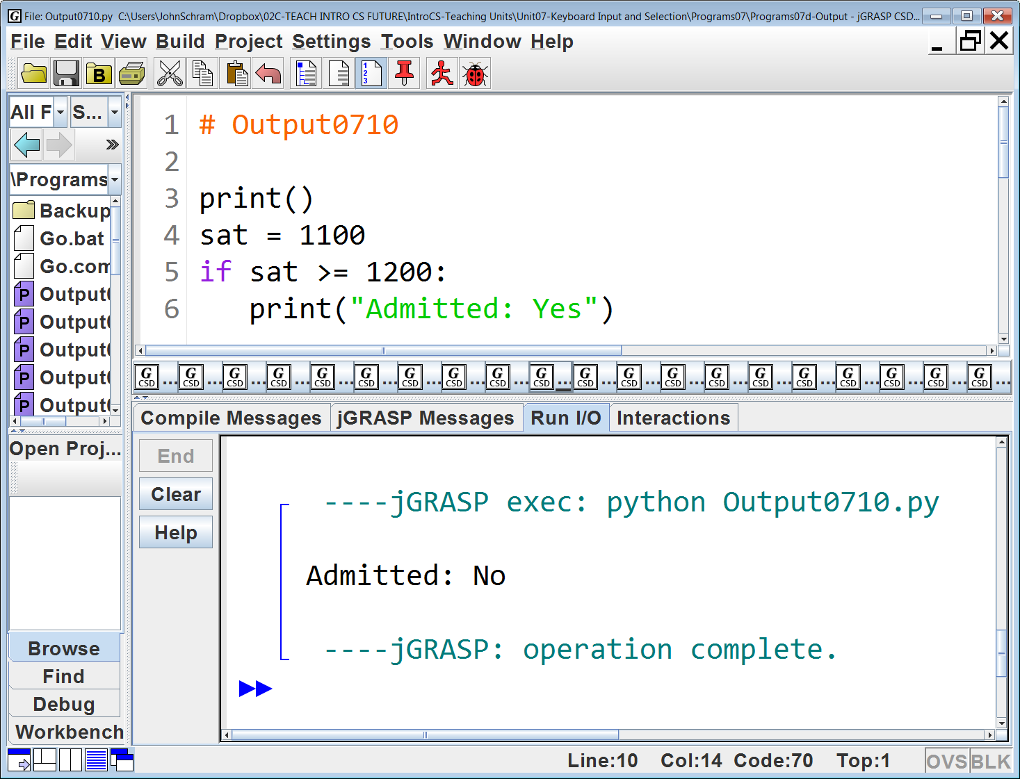

Slide 26
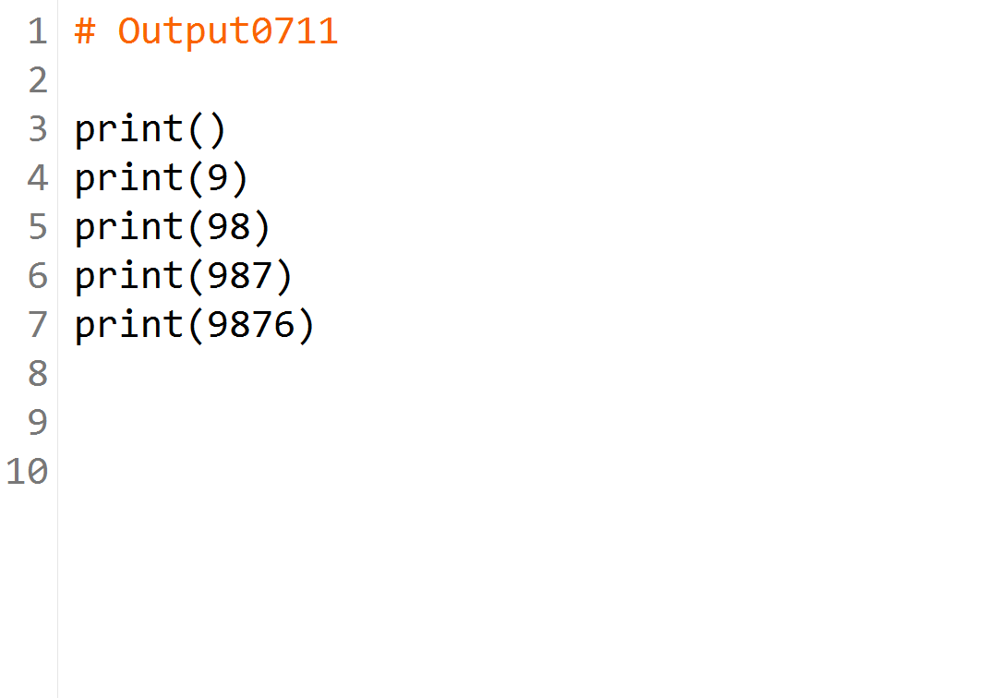

Slide 27
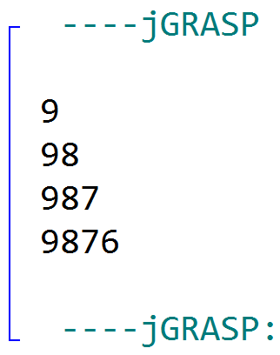

Slide 28
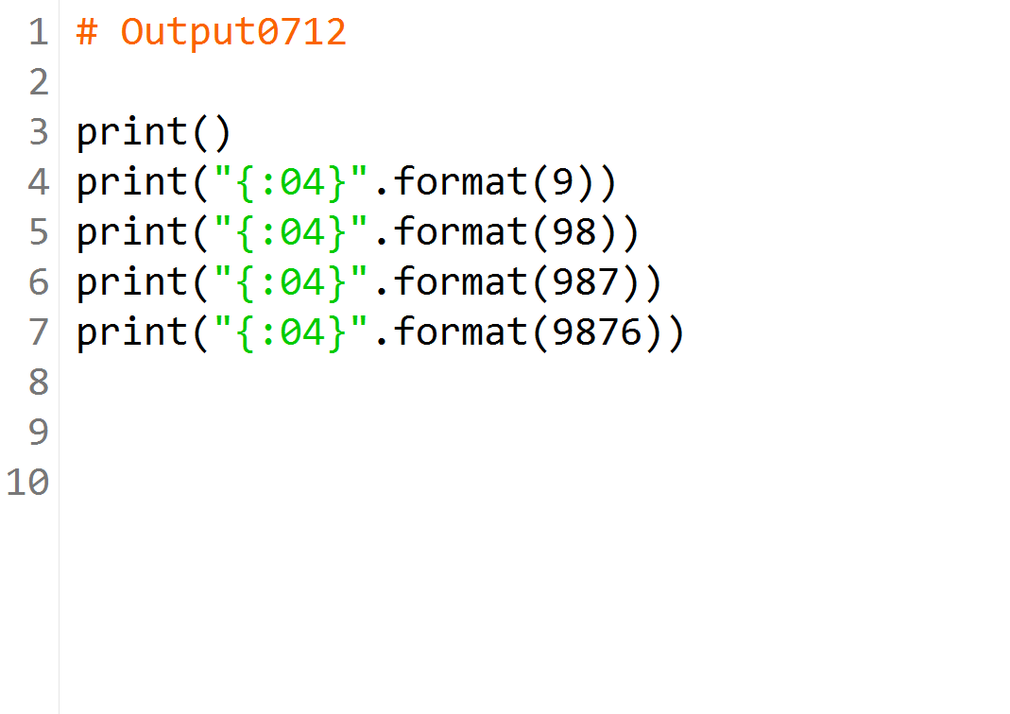

Slide 29
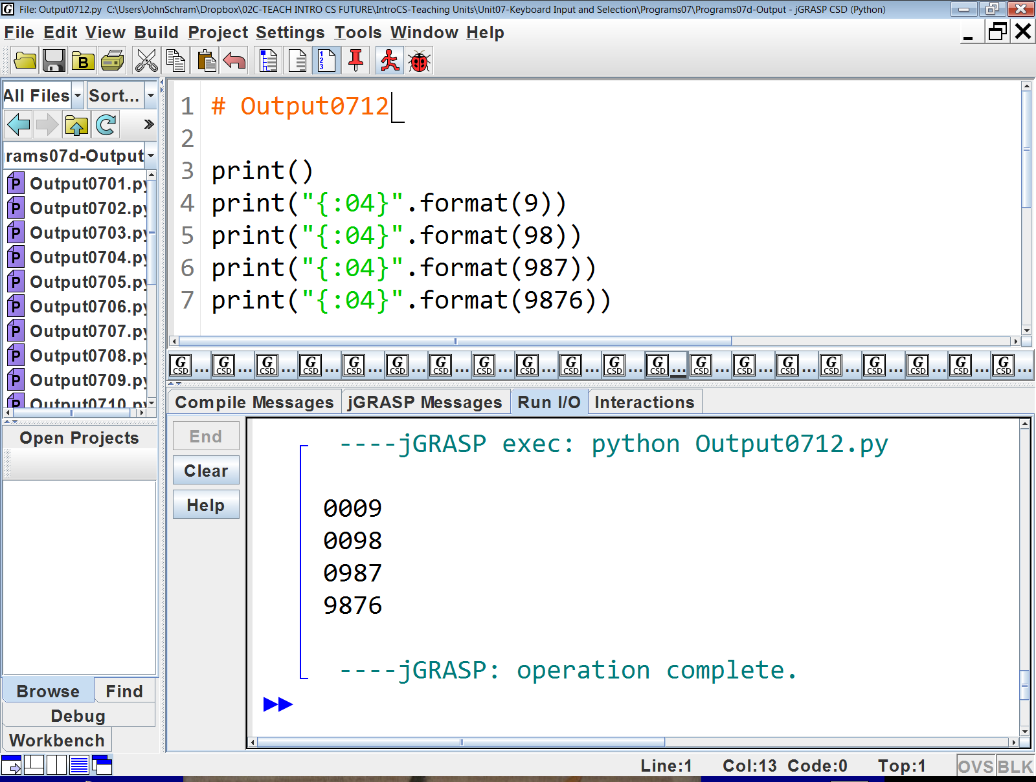

Slide 30


Slide 31
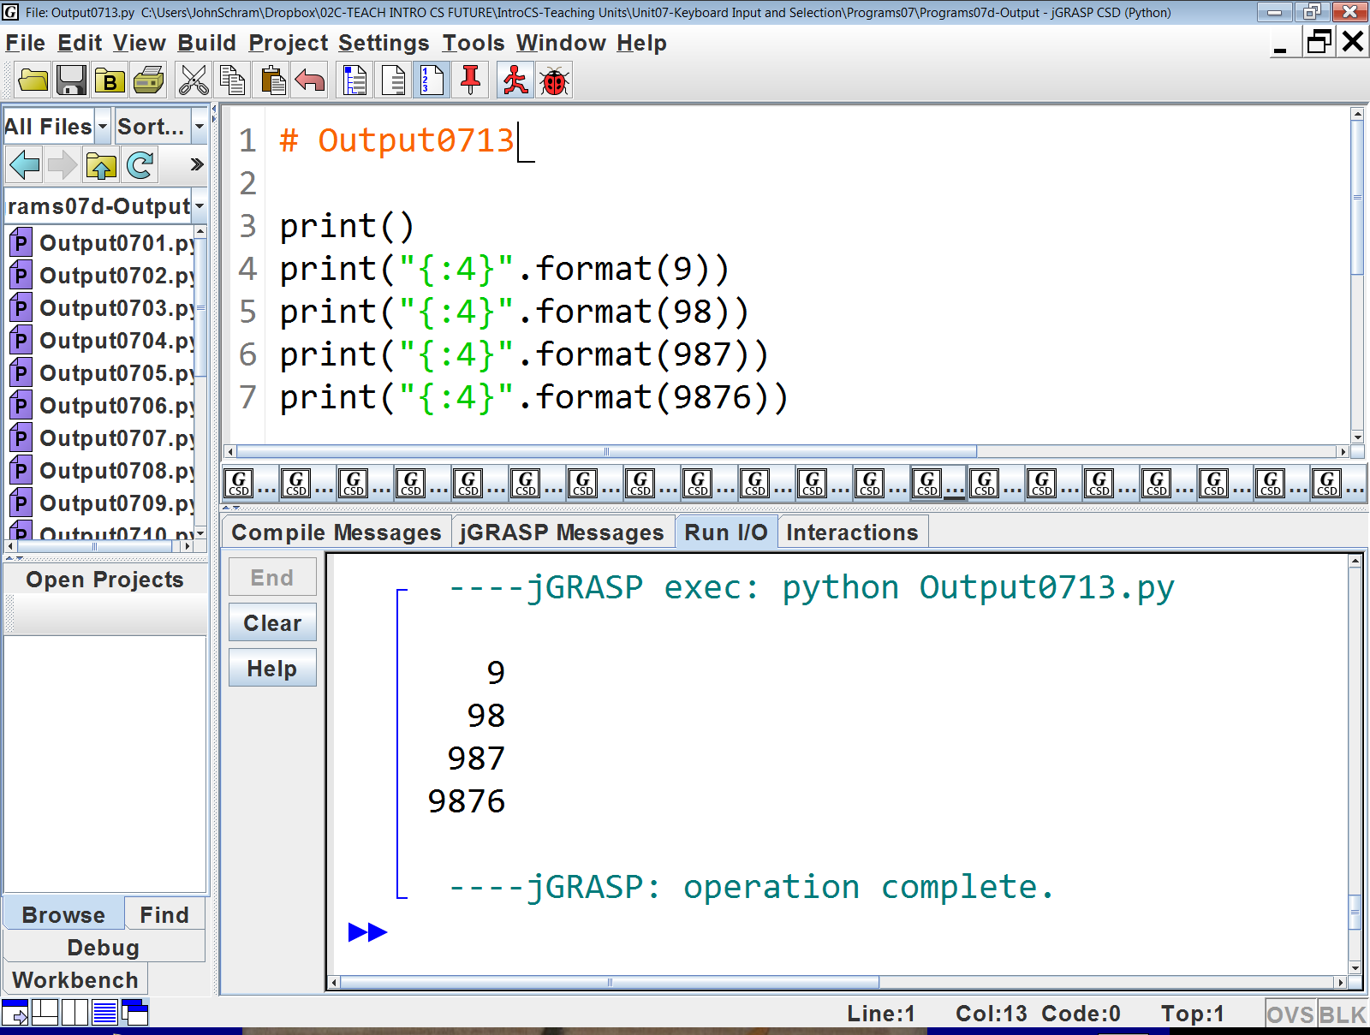

Slide 32
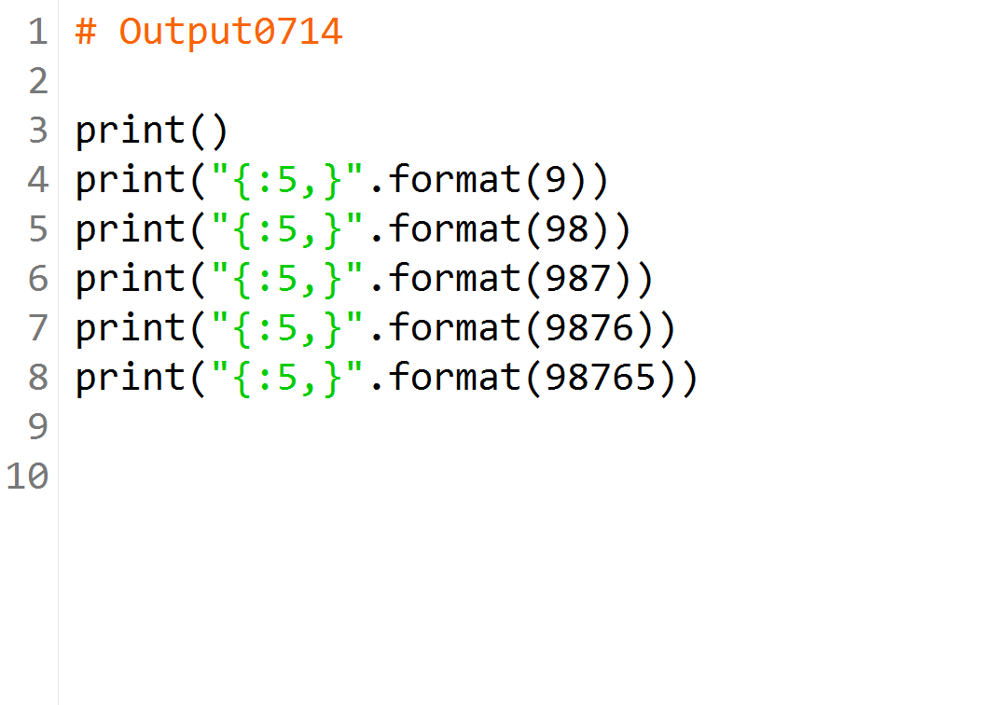

Slide 33
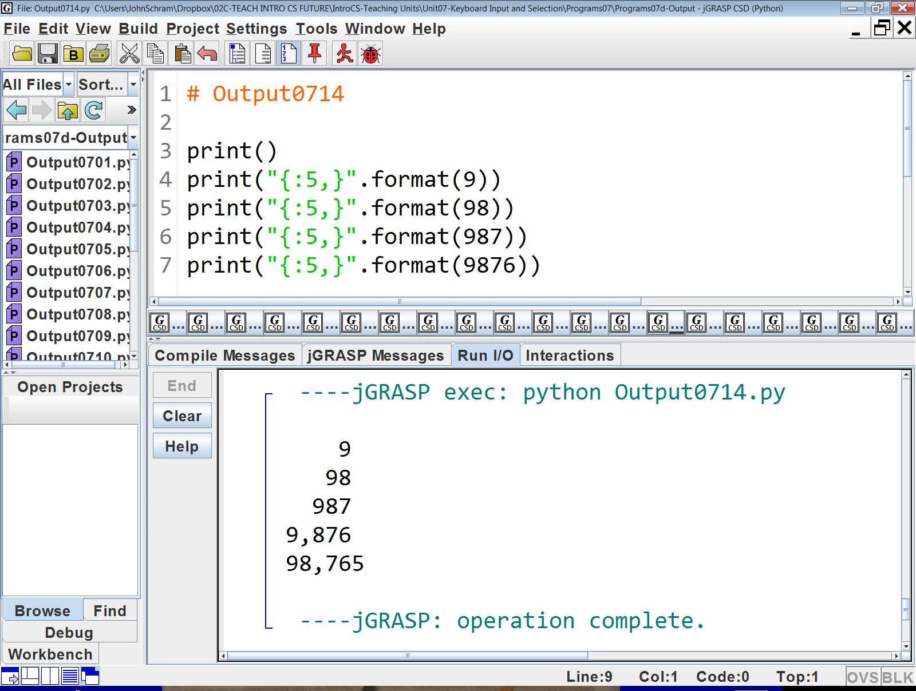

Slide 34
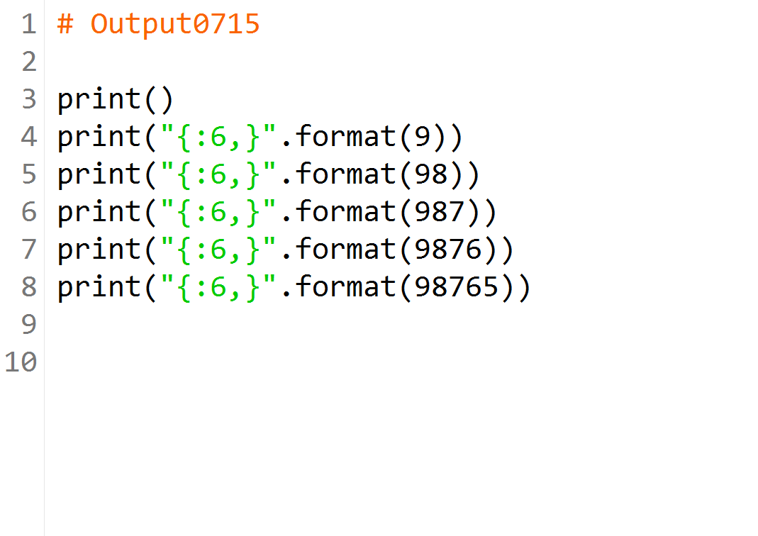

Slide 35
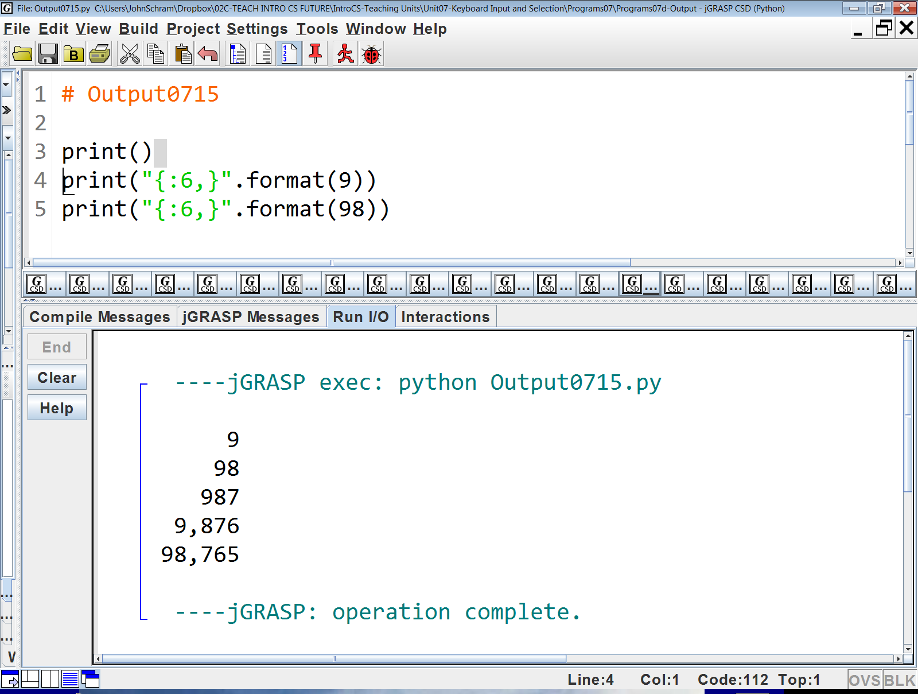

Slide 36
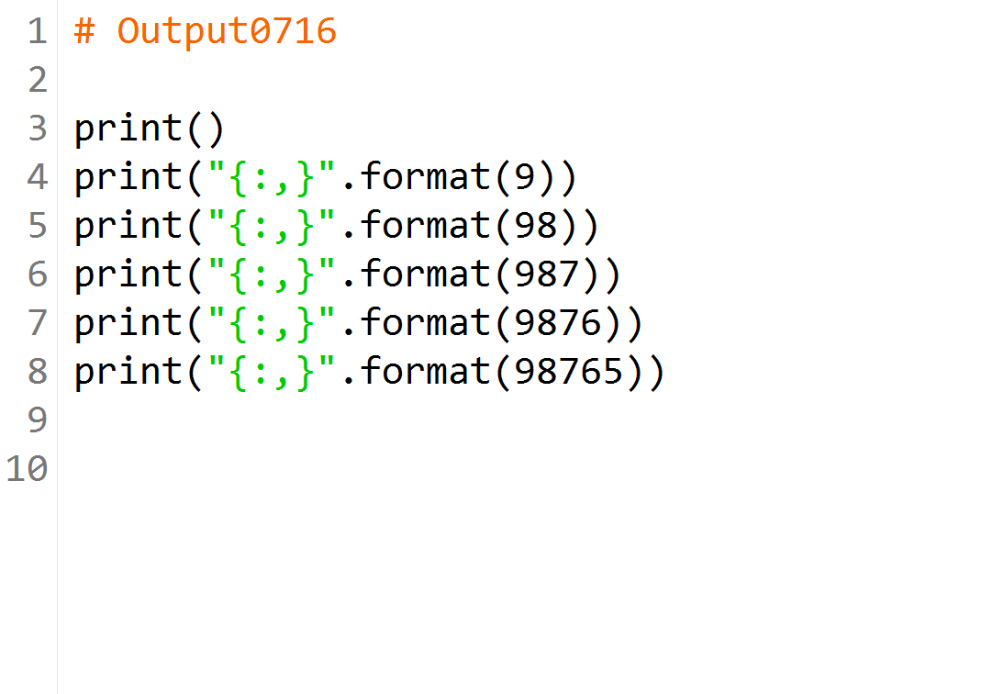

Slide 37
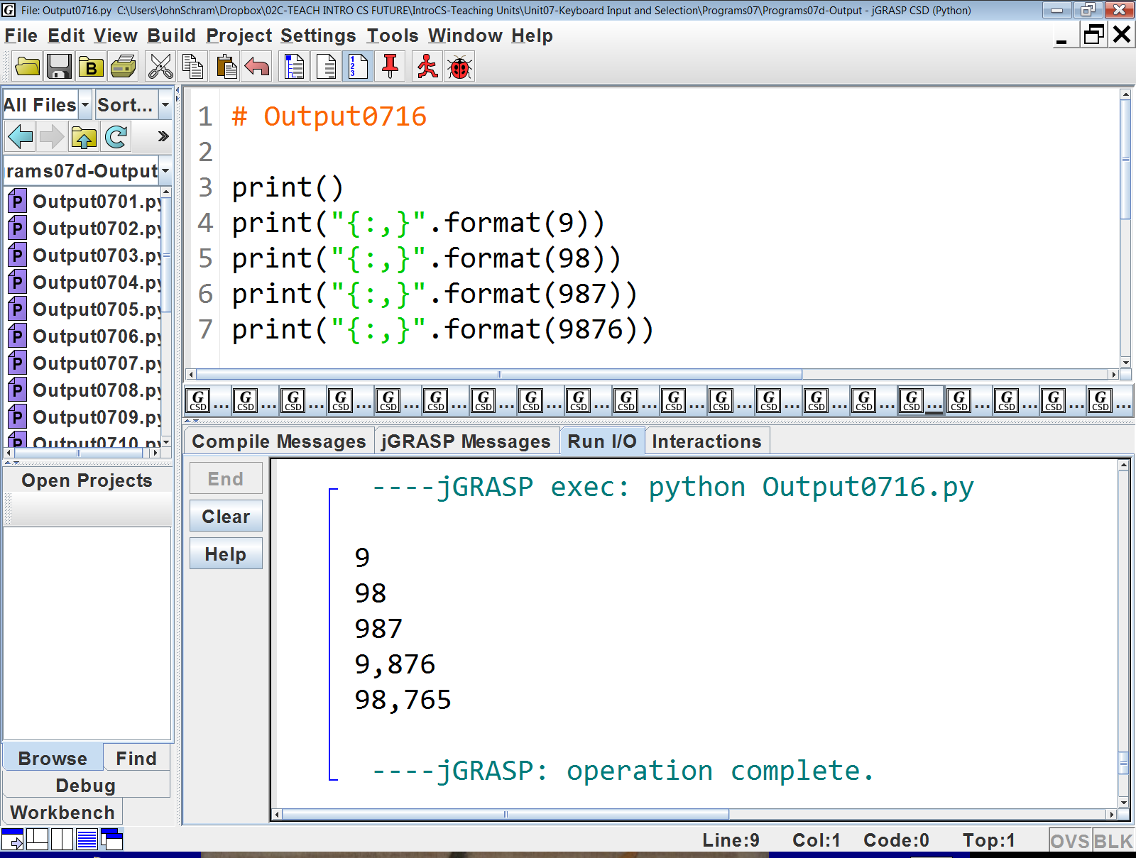

Slide 38
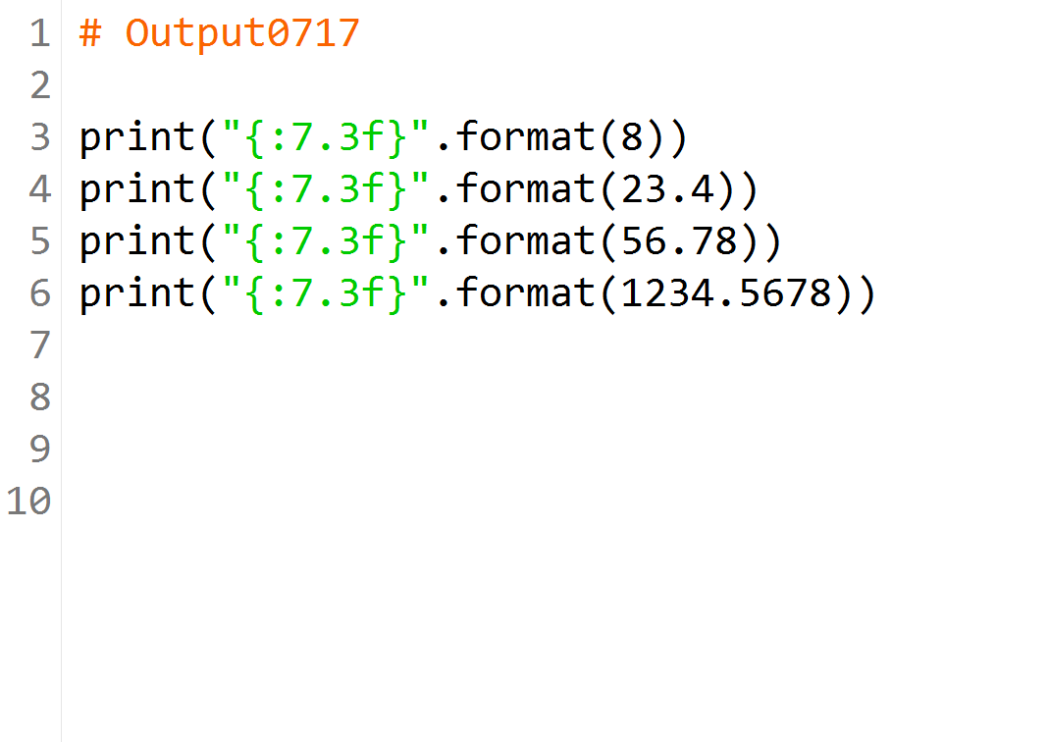

Slide 39
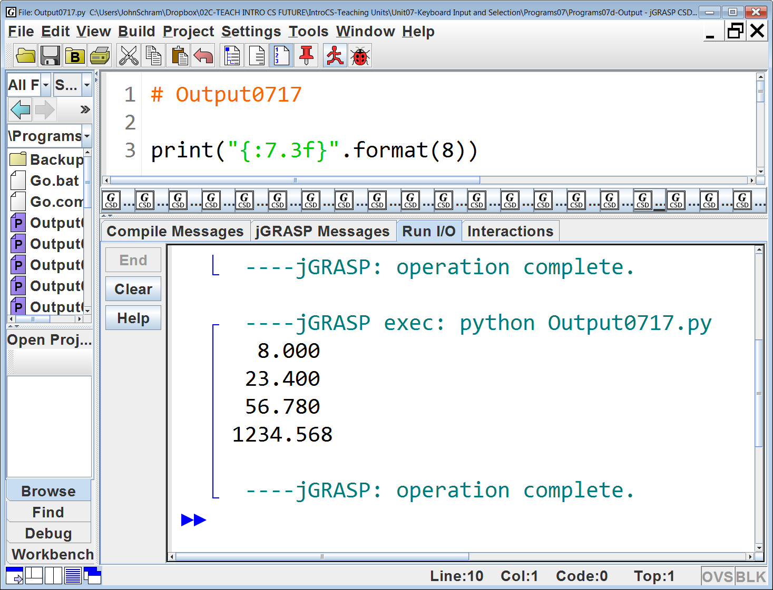

Slide 40
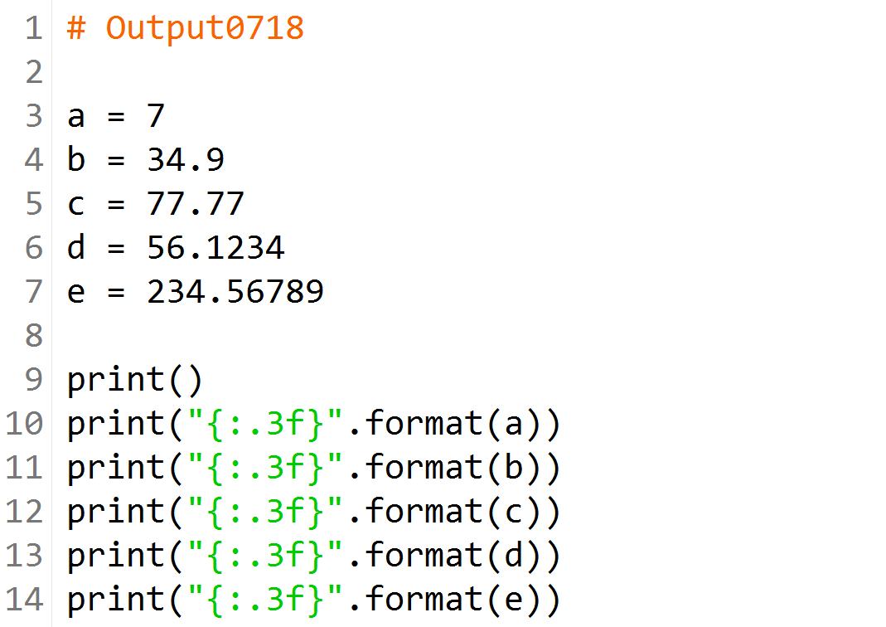

Slide 41
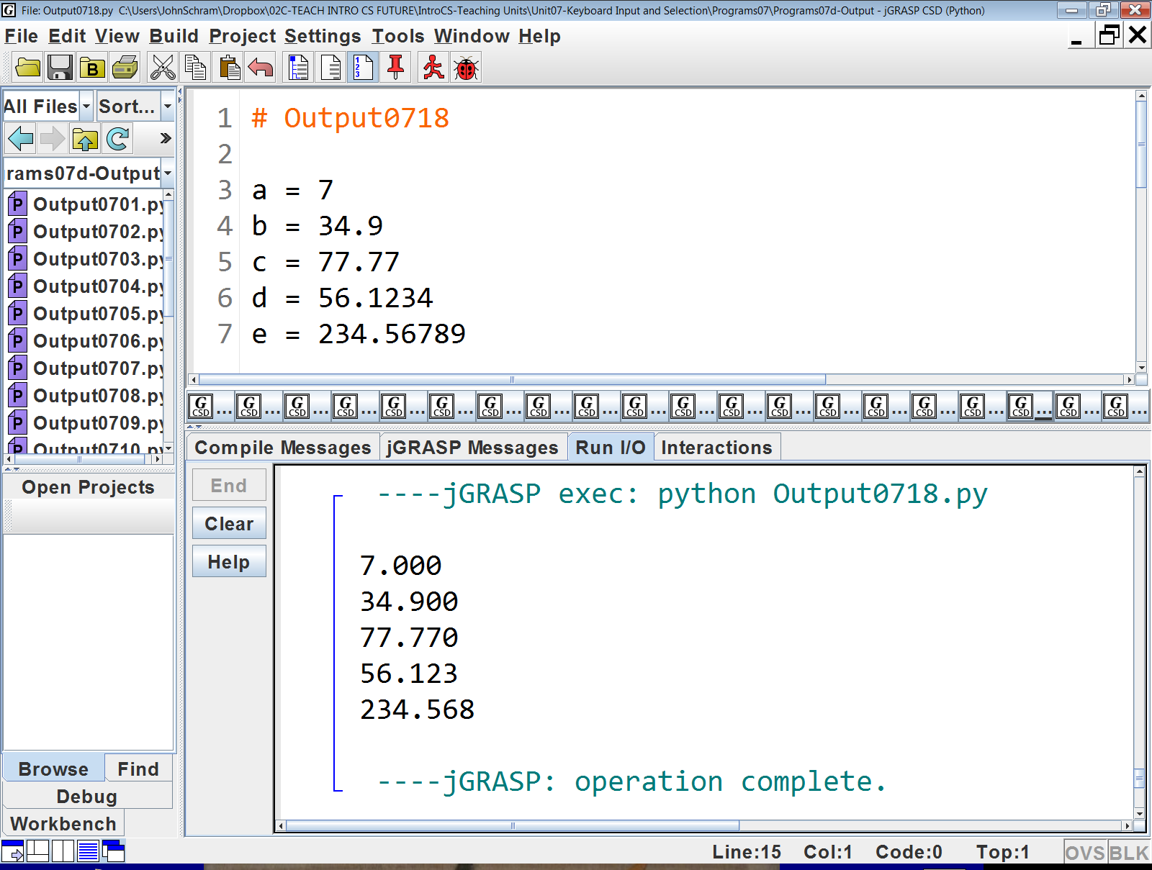

Slide 42
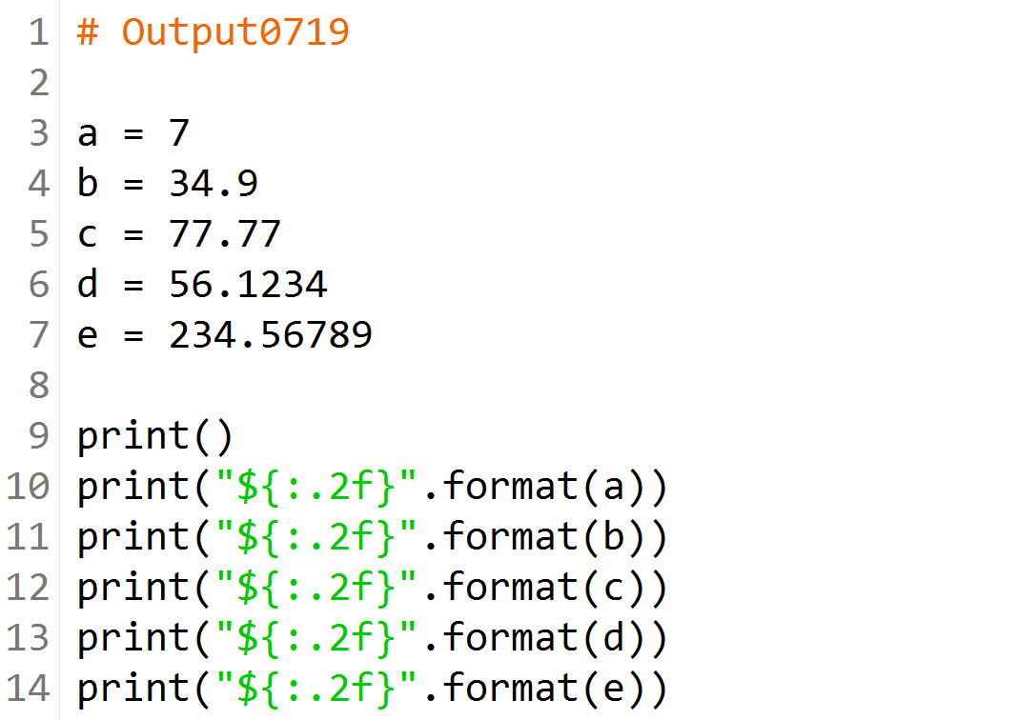

Slide 43


Slide 44
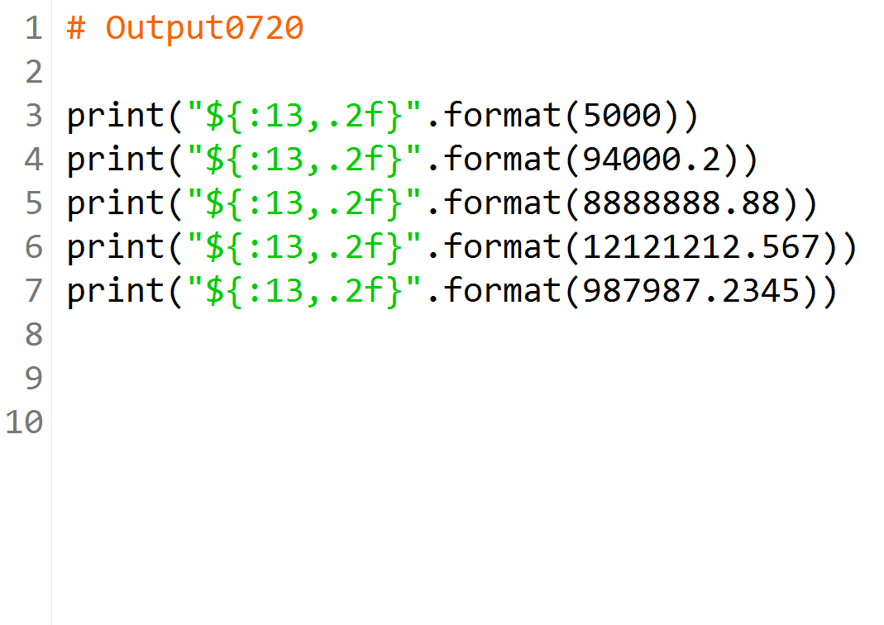

Slide 45
